Slide 1
Section 4
Niches: Shaping Communities

Slide 2
What You’ve Learned So Far
Communities
Populations & their growth
Relationships

Slide 3
Our Niche
There is no organism that can live everywhere.
Even as humans, we have a limitation to where we can realistically inhabit,
Almost all the time, in order for an organism to be at its best, at its highest fitness, it has it’s own set of specific conditions (habitat and community) that it functions in.
Today you are going to learn about how organisms fit into the puzzle that is an ecosystem.

Slide 4
Our Niche
In a study of populations, communities, and ecosystems, it’s important to study just how communities influence.
To say that life as we know it is a miracle is a gross understatement.
Through millions of years of conflict, competition, changing and adapting, our Earth is filled with miraculous webs of life that exist in a delicate balance.

Slide 5
Learning Objectives Part 4
Explain why an organism’s role is important for a community.
Describe one example of how competition for resources affects species in a community.
Determine the aspects that determine an organism’s fundamental and realized niche.
Know the difference between a niche & a habitat.
Vocabulary
Niche
Fundamental niche
Realized niche
Competitive exclusion
Keystone species

Slide 6
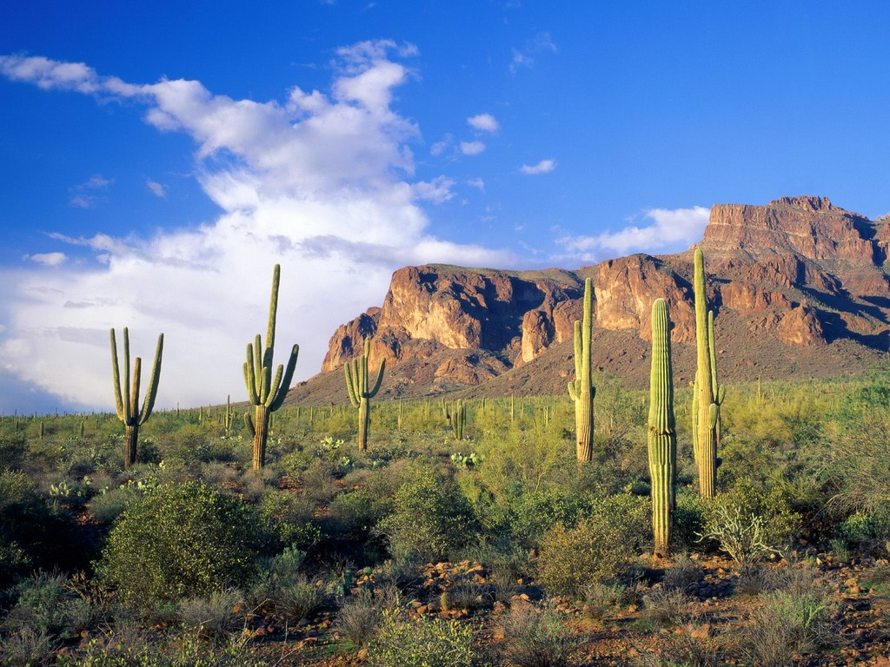
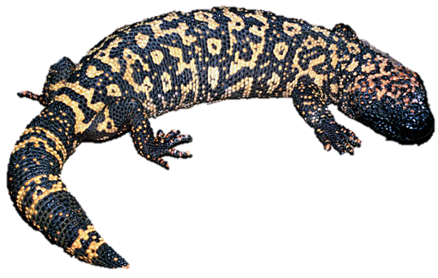
Imagine this habitat is the Superstition Mountains in the East Valley
Niche
Any organism that lives here has everything it can eat on “the menu”.
It has all the space to find a home in.
Does a Gila Monster live everywhere in the desert? Does it eat everything?
Exactly what the organism chooses to use to satisfy its needs will determine the unique behaviors of the organism.
This is called its niche.

Slide 7
Carving a Niche
The unique position occupied by a species, both in terms of its physical use of its habitat and its function in an ecological community, is called a niche.
A niche is not the same as a habitat.
A habitat is only the physical space where an organism lives.
A niche includes the role that the organism plays in the community.
I.e. when it sleeps/hunts/reproduces, how it uses the resources in its ecosystem for shelter & sustenance, is it a consumer, producer, herbivore, omnivore, etc.

Slide 8
Carving a Niche
What types of food can you eat?
All sorts right, but mainly grains, meats, vegetables, etc.
You have a variety of options right?
Where can you live?
In a house, but you can also live in a cave, underground, in a tree, in a tent in the woods.
You choose where you want to live.
Why wouldn’t you choose to live in a cave?
Lots of reasons.
All animals can eat all kinds of things, from plants to animals, from a variety of sources and live in a variety of places.
But they choose to live where they do and eat what they eat.
Why do you think?

Slide 9
Competing for Resources
The entire range of conditions where an organism or species could survive is called its fundamental niche.
The conditions are very numerous but they begin to include all the parts of the habitat that the organism could use if it needed to.
You should assume an organism is unable to use all of this though.
This is because many species’ fundamental niches overlap with other species’.
Sometimes, when limited resources are shared, species compete for them.
Because of competition, a species almost never inhabits its entire fundamental niche.

Slide 10
A Fundamental Niche…
Fundamental Niche
All Habitat
Food
It’s role (Predator/prey/carnivore/herbivore)
When it hunts (Night/day/morning)
It’s water source.
If it hibernates.
Everything that could be…

Slide 11
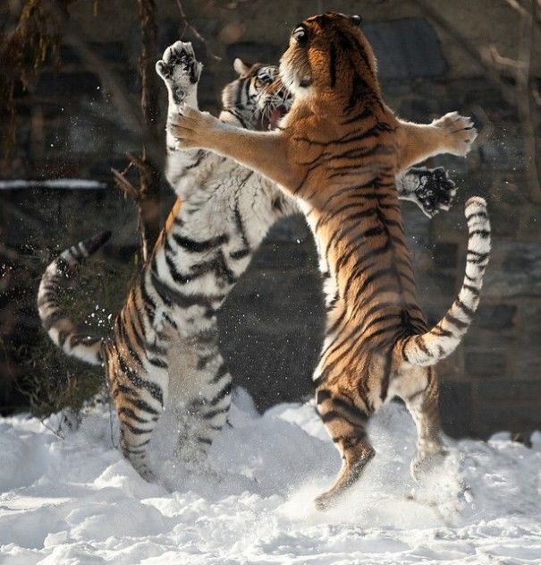
Competing for Resources
Often, fundamental niches overlap.
Competition for resources between organisms shapes its fundamental niche... and influences the actual niche the organism will inhabit.
Competition sounds harsh but it isn’t all bad.
This drives organisms into every crack and crevice, creates all the unique characteristics seen amongst organisms, trying to avoid competition at all costs.

Slide 12
A Niche Shared…
Niche
A
Niche
B
Competition
Organisms tend to avoid or adapt to the overlap.

Slide 13
Competing for Resources
Competition, in whatever form, has had several possible outcomes.
Winners, losers.
Losers eliminated.
Avoidance or cooperation.
Competing species are able to survive together because they divide the resources in a variety of ways.

Slide 14
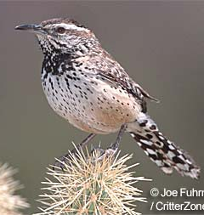
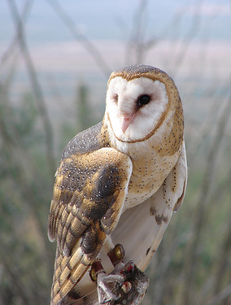
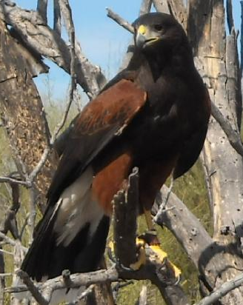
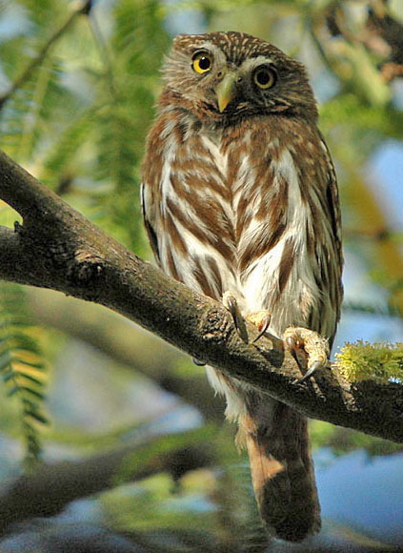
In order to reduce competition… Different birds have different hunting patterns.
Niche
Organism A
Niche
Organism B
They may live in the same habitat but their niches are different.
How do they avoid competing for the same resources?
The owls hunt at night.

Slide 15
Types of Competition
No two species that are too similar can coexist because they are too similar in their needs.
In general, there are two main types of competition:
Interspecific Competition: Competition between different species.
Intraspecific Competition: Competition between individuals within the same species.
Eventually, the better competitor will be the only one left.
One species eliminating another through competition is called competitive exclusion.

Slide 16
Competing for Resources
The result of competition and an organism’s inherent adaptations to survive will limit access to the fundamental niche.
What’s left over is the realized niche.
This is the actual niche that a species occupies in a community.
This is the niche an organism occupies as a result of competition.
Usually, organisms don’t stray too far outside of these niches for self-preservation’s sake.

Slide 17
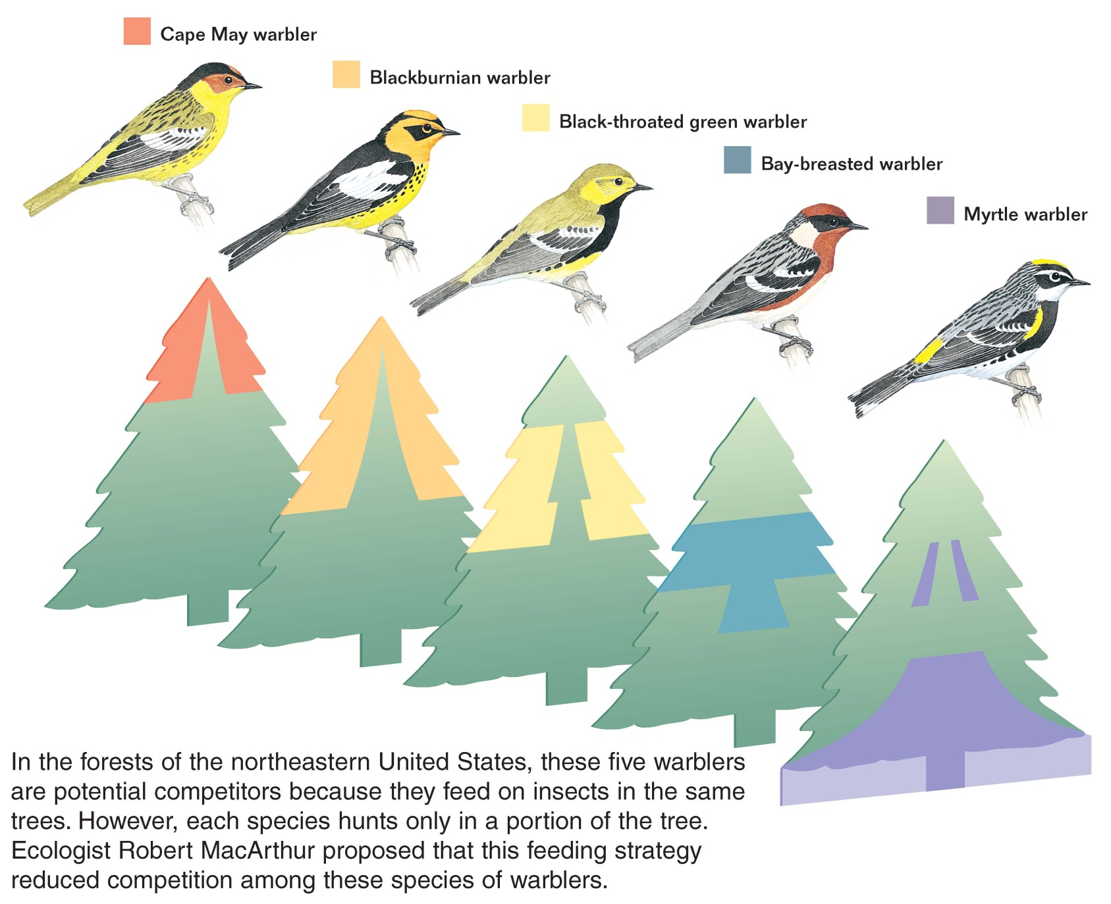
Warbler Foraging Zones Avoiding Competition
You will rarely see a Cape May in the lower portions of a tree or a Myrtle in the upper portions of the tree feeding.
Why?
To reduce competition for the same resource.

Slide 18
Concept Check. Competitive Exclusion
Barnacles feed of nutrients in the ocean, plankton and algae.
They usually live in coastal regions, or at least in shallow water where sunlight is readily available.
There are many types, each a little different.
On occasions different barnacle species can occupy the same area and attempt to feed on the same food sources.

Slide 19
Study this picture for 1 minute. Read the captions and identify the features of each species. There are 6 accompanying questions which you will have 1 minute to answer each slide.

Slide 20
1. Because the two species of barnacles attempt to use the same resources, they are
a. parasites. c. mutualistic.
b. competitors. d. symbiotic.
2. Diagram A indicates that the barnacle Chthamalus stellatus can live in both shallow and deep water on a rocky coast. This is the barnacle’s
a. competitive niche. c. fundamental niche.
b. realized niche. d. exclusive niche.

Slide 21
3. Diagram B indicates that the barnacle Balanus balanoides prefers to live in deep water. Deep water is the barnacle’s
a. competitive niche. c. fundamental niche.
b. realized niche. d. exclusive niche.
4. Diagram C indicates that when the two barnacles live together, Chthamalus is restricted to shallow water. Shallow water is this barnacle’s
a. competitive niche. c. fundamental niche.
b. realized niche. d. exclusive niche.

Slide 22
5. Which picture shows interspecific competition?
a. A c. C
b. B d. Both A & B
6. Which picture shows intraspecific competition?
a. A c. C
b. B d. Both A & B

Slide 23
How did you do?

Slide 24
1. Because the two species of barnacles attempt to use the same resources, they are
a. parasites. c. mutualistic.
b. competitors. d. symbiotic.
2. Diagram A indicates that the barnacle Chthamalus stellatus can live in both shallow and deep water on a rocky coast. This is the barnacle’s
a. competitive niche. c. fundamental niche.
b. realized niche. d. exclusive niche.

Slide 25
3. Diagram B indicates that the barnacle Balanus balanoides prefers to live in deep water. Deep water is the barnacle’s
a. competitive niche. c. fundamental niche.
b. realized niche. d. exclusive niche.
4. Diagram C indicates that when the two barnacles live together, Chthamalus is restricted to shallow water. Shallow water is this barnacle’s
a. competitive niche. c. fundamental niche.
b. realized niche. d. exclusive niche.

Slide 26
5. Which picture shows interspecific competition?
a. A c. C
b. B d. Both A & B
6. Which picture shows intraspecific competition?
a. A c. C
b. B d. Both A & B

Slide 27
Concept Check: Choose the letter of the answer.
What is the entire habitat that an organism can inhabit?
D. Fundamental Niche
What is the habitat that the organism eventually inhabits called?
C. Realized Niche
Why do organisms avoid parts of the entire habitat they could otherwise use?
A. Competition!
A. Competition
B. Competitive exclusion
C. Realized niche
D. Fundamental niche
E. Keystone Species

Slide 28
Competition Hasn’t Ruined an Ecosystem’s Strength
You may think with all the struggle the Earth is in constant turmoil.
This is for the most part correct but it’s not all bad.
Our Earth is fragile, yes, but it’s also quite flexible.
Not that it can do the splits…but it can respond.
It’s based upon the health of each ecosystem.
Does anyone remember what determines the health of an ecosystem?
It’s biodiversity.
Despite the constant competition, the Earth is constantly working towards balance and accommodating all life forms.
It does this through biodiversity.

Slide 29
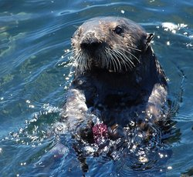
Ecosystem Resiliency
Predation is important to an ecosystem.
It reduces the affects of competition.
Predators can influence more than their prey. When predators eat one species, they may reduce competition among other species.
Examples: Otters eating sea urchins to save the kelp forests. Others.
Sometimes, a predator’s role is so important, disproportionate, to the health of an ecosystem it has a special title…a keystone species.
A keystone species is a species that is critical to an ecosystem because the species affects the survival and number of many other species in its community.

Slide 30
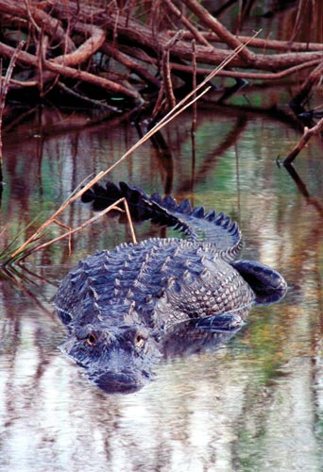
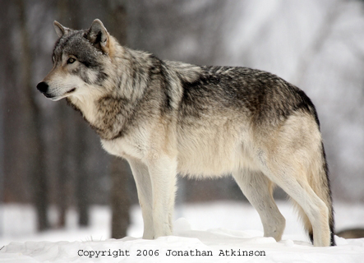
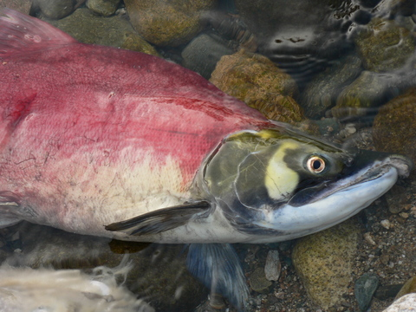
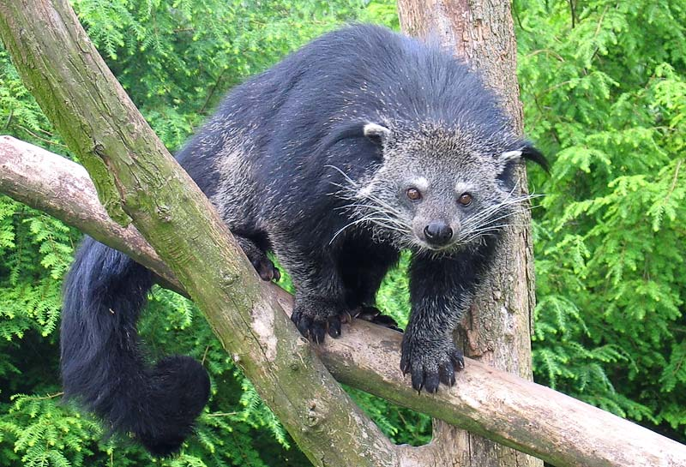
Some Other Keystone Species…
The Grey Wolf
Salmon
Alligator
Asian Bear Cat
Beaver, prairie dog, the list goes on!

Slide 31
Ecosystem Resiliency
Ecosystems can be destroyed or damaged by severe weather, humans, or introduced species. Other factors can help keep an ecosystem stable.
Interactions between organisms and the number of species in an ecosystem add to the resiliency of an ecosystem.
Higher biodiversity often helps make an ecosystem more resilient.
As a result, biodiversity is the most important factor in an ecosystem’s resiliency, or strength.

Slide 32
Summary
A niche includes the role that the organism plays in the community. This role affects the other organisms in the community.
Competition for resources in the fundamental niche between species shapes a species’ realized niche.
Interspecific competition results from different species in conflict over the same resources. Intraspecific competition results from the conflict that results from the same species. Competitive exclusion is the result of the better competitor eliminating the weaker competitor.
Interactions between organisms and the number of species in an ecosystem add to the stability of an ecosystem.

Slide 33
Group Work: POGIL Relationships
Work together in your groups and complete the study into the organisms in the example.
We will cover the answers with 10 minutes left in class.

